Slide 1
Upravaljanje mrežama

Slide 2
Uvod
Životni ciklus mreže
Praćanje i analiza rada mreže
  “Tapovanje” mreže
  SNMP
  NetFlow
Optimizacija rada mreže i kvalitet servisa
  Kvalitet servisa
  Uvođenje pravila i oblikovanje saobraćaja

Slide 3
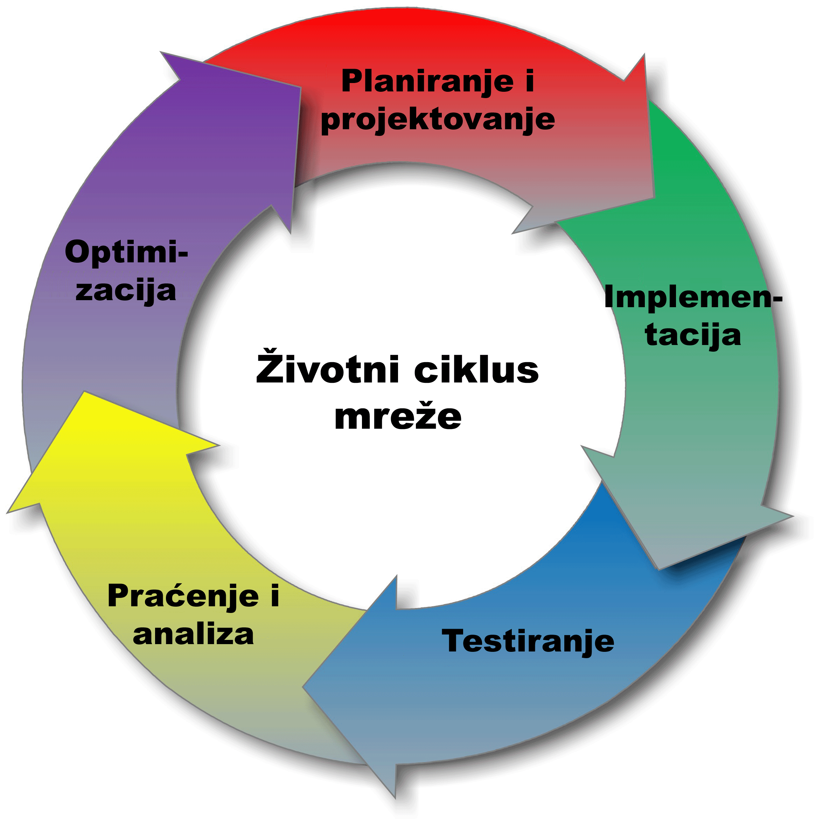
Životni ciklus mreže

Slide 4
Praćenje i analiza rada mreže

Slide 5
Praćenje i analiza rada mreže
Zbog efekta koji stvara konvergercija različitih tipova saobraća na istoj mreži i različitih zahteva po pogledu propusnog opsega različitih protokola, subjektivni utisak rada mreže može biti negativan, čak i u slučaju mreže velikog kapaciteta.
Zbog toga je neophodno konstantno pratiti i analizirati rad mreže, i konstntno unapređivati mrežu kako bi se postigao bolji subjektivni utisak o radu mreže.
Praćenje rada mreže podrazumeva:
  Merenje realnog protoka na ključnim tačkama u mreži (najčešće izlaznim linkovima ka internetu i drugim mrežama)
  Merenje parametara pojedinih protokola
  Praćenje učestalosti eventualnih otkaza
Analiza podrazumeva:
  Analizu udela u ukupnom saobraćaju po
    krajnjim uređajima
    protokolima
    tipovima saobraćaja
    ...

Slide 6
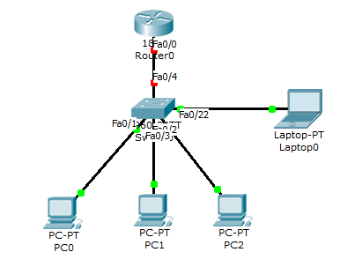
Tapovanje mreže
Tapovanje mreže je legitiman način za administratore da izvrše analizu saobraćaja tako što se svaki paket koji prođe kroz port koji se prati se kopira i na port swiča sa softverom za snimanje saobraćaja (korisnici ne primećuju promenu).
“Tap” – eng. ispust
  “tapuje” se obično izlazni link na svišu na neki uređaj koji može da snima i analizira saobraćaj
  Na Cisco sviču ovo se postiže sa dve naredbe monitor session

Slide 7
Wireshark
Računar (uređaj) na koji se preusmerava “tapovani” saobraćaj treba imati mogućnost snimanja i analize saobraćaja.
Jedan od poznatijih programa za ovu namenu je Wireshark.
Wireshark je open source softwer za PC računare koji snima kompletan saobraćaj na zadatoj mrežnoj kartici.
Snimljeni saobraćaj se naknadno može analiziati iz ovog alata po mnogo osnova.

Slide 8
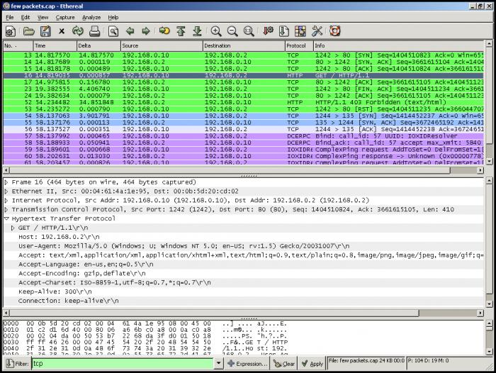
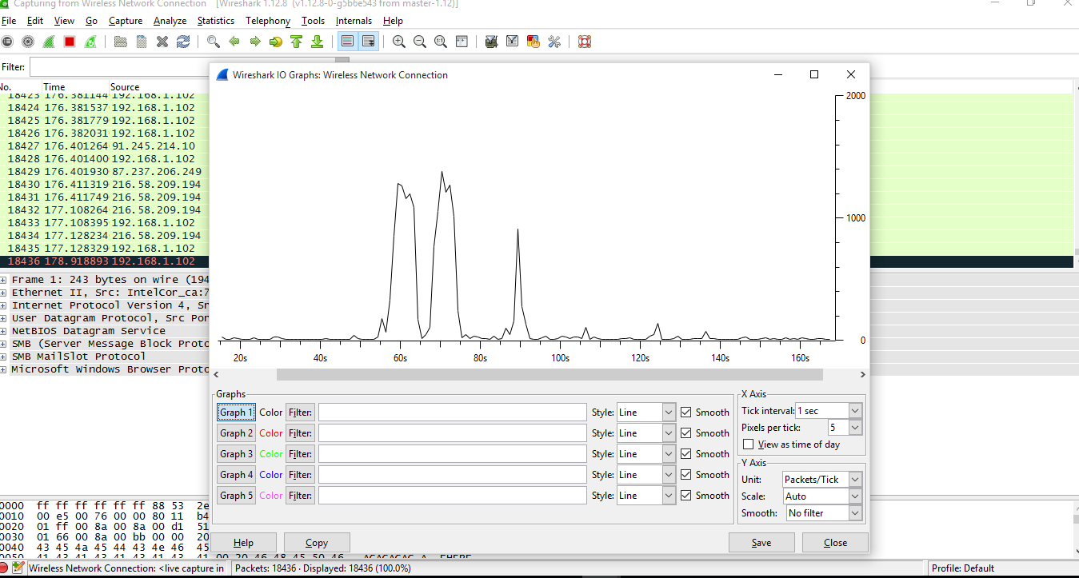
Wireshark

Slide 9
SNMP
SNMP (Simple Network Management Protocol) je protokol koji omogućava prikupljanje informacija sa mrežnih uređaja i delimično upravljanje radom uređaja.
SNMP protkolom se mogu prikupljati informacije sa servera, radnih stanica, rutera, svičeva, ...
Za razliku od tapovanja mreže, SNMP protokolom se salje samo sažetak informacija prikupljenih na uređajima, a ne kompletan protok.
Komponente SNMP sistema uključiju agente i menadžere
  Agenti – softverski procesi koji se startuju na uređajima sa kojih se prikupljaju informacije i kojima se upravlja
  Menadžeri – procesi koji se izršavaju na radnim stanicama pomoću kojih se upravlja mrežom. Uloga im je preriodično prikupljanje informacija.

Slide 10
SNMP
SNMP koristi User Datagram Protocol (UDP) kao transportni mehanizam
Ethernet Frame
IP Packet
SNMP Message
CRC
UDP Datagram
Portovi:
UDP Port 161 - SNMP Messages
UDP Port 162 - SNMP Trap Messages

Slide 11
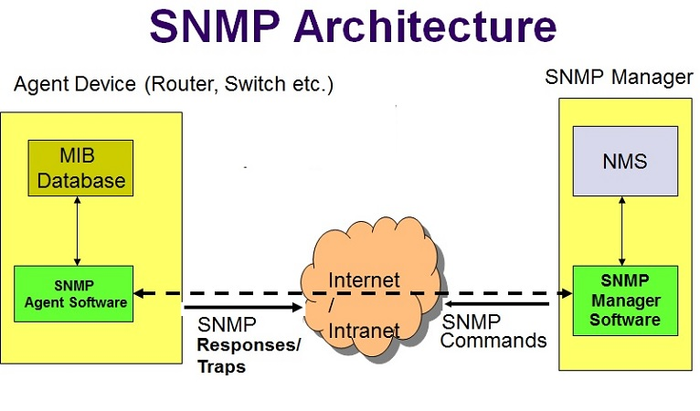
SNMP arhitektura
Pojednostavljeno rečeno, MIB baza je “registar” numeričkih oznaka
pojedinih parametara koje je moguće pratiti ovim protokolom.
Svaka poruka sadrži MIB-oznaku parametra i samu vrednost parametra
ili naredbu koju je potrebno izvršiti nad tim parametrom

Slide 12
NetFlow
NetFlow je protokol aplikativnog nivoa koji za razliku od SNMP-a nema mogućnost upravljanja mrežom, već samo nadgledanja rada mreže.
Svi paketi sa istog izvora ili odredišta, IP adrese, izvornog ili odredišnog porta interfejsa i klase servisa se grupišu u “tokove”.
Tok predstavlja apstraktni pojam o kom se prikupljaju statistički podaci.
Podaci o toku se pamte u NetFlow keš.
Ceo postupak se obavlja na ruteru.

Slide 13
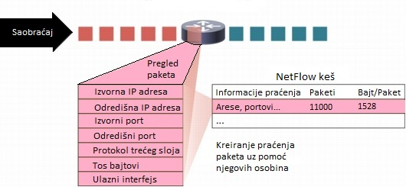
NetFlow
Postoje dve glavne metode za pristup NetFlow podacima:
  show naredbama iz komandne linije (CLI) na ruteru,
    NetFlow CLI je veoma pogodan za brz uvid u protok i rešavanje problema.
  korišćenje posebnih softverskih paketa koji prave izveštaje o podacima NetFlow-a na posebnim računarima.
    Drugi izbor se naziva eksportovanje NetFlow-a na server.
NetFlow kolektor je softver koji ima zadatak razumevanja eksportovanih praćenja i kombinovanje ili agregaciju podataka da proizvede važne izveštaje o saobraćaju i izveštaje o sigurnosnim analizama

Slide 14
NetFlow CLI
router# show ip flow top 10 aggregate protocol
  Ova naredba nam prikazuje 10 protokola koji trenutno teku kroz ruter.
router# show ip flow top 10 aggregate source-address sorted-by packets
  prikazuje IP adrese koje šalju najviše paketa.
router# show ip flow interface
  Prikazuje da li je saobraćaj na portu rutera ulazni (Ingress), ili izlazni (Egress).
...

Slide 15
Eksportovanje NetFlow podataka
Komanda za podešavanje izvornog porta sa kog se prikuplja statistika o tokovima (zadaje se u interfejsu):
  ip flow-export source G0/1
Podešva se verzija NetFlow zaglavlja:
  ip flow-export version 9
Posle podešavanja verzije treba se odrediti odredište kom računaru se šalju NetFlow paketi kako bi se uspostavio monitoring na samom tom računaru
  ip flow-export destination {adress} {port}
Eksportovanje NetFlow podataka je poželjno jer se više mrežnih uređaja može pratiti sa jednog računara.

Slide 16
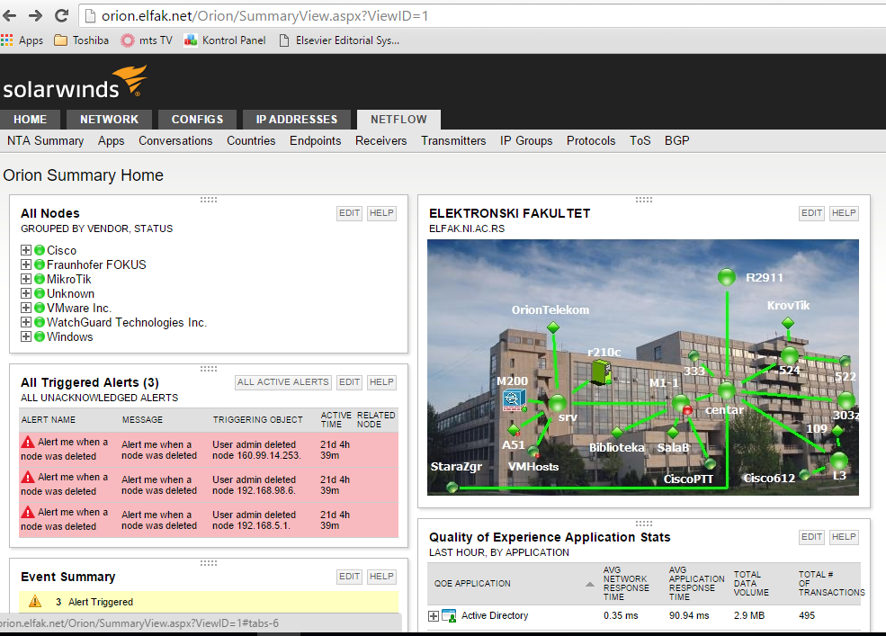
NetFlow serverske aplikacije
Primer: Orion SolarWinds

Slide 17
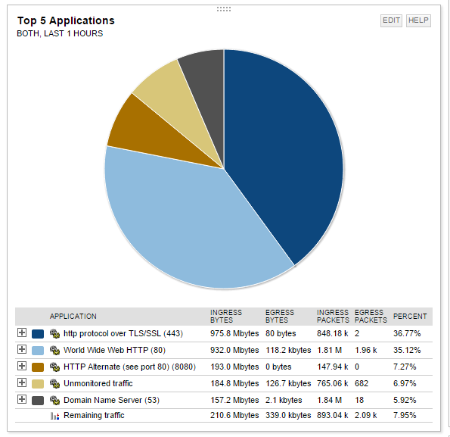
NetFlow serverske aplikacije
Primer: Orion SolarWinds

Slide 18
Optimizacija rada mreže i kvalitet servisa

Slide 19
QoS – Quality of Service
Pod pojmom “kvalitetet servisa” podrazumeva se subjektivni utisak rada mreže.
Glavni problem sa subjektivnim utiskom u tome da su današnje mreže zapravo mreže sa konvergiranim servisima, odnosno preko iste mreže se prenosi saobraćaj istog tipa.
  Na primer, na 100 MBps lokalnoj mreži, može da se desi da jedan korisnik downloaduje veliku količinu podataka i zauzima većinu propusnog opsega, pa je korisnicima koji koriste VoIP ili IPTV veza praktično neupotrebljiva.
Kada se govori o kvalitetu servisa, podrazumeva se mreža čiji se propusni opseg ne menja, ali se vrše podešavanja tako da je subjektivni utisak korisnika takav da mreža “radi brže”.
S tim u vezi, u literaturi se obično sreće fraza: “QoS is zero-sum game”!
  Ovo oslikava činjenicu da je propusni opseg konstantan i da bi se povećao kvalitet jednog servisa, mora se narušiti kvalitet nekog drugog servisa.

Slide 20
QoS – Quality of Service
Načini za obezbeđivanje kvaliteta:
  Davanje prioriteta različitim tipovima saobraćaja (Priority Queueing).
  Oblikovanje saobraćaja zadavanjem pravila (Traffic Policing and Shaping)
  Kombinacija prethodna dva.

Slide 21
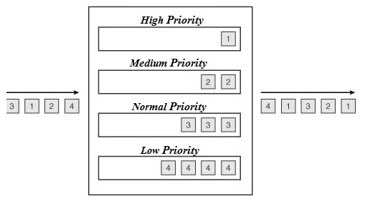
Priority Queueing
PQ se implementira sistemom sa četiri reda čekanja različitog prioriteta (high, medium, normal, low).
Najpre se opslužuje red najvećeg prioriteta, a nakon toga se prelazi na opsluživanje ostalih, uz konstantnu proveru statusa reda najvišeg prioriteta.
PQ ima za posledicu veoma malo kašnjenje u redovima većeg priorteta.

Slide 22
Primer
Primer bez proiriteta:
  Kroz 100 Mbps mrežu prolazi intenzivan download fajlova sa interneta od 99.9 Mbps i VoIP poziv od 0.1 Mbps.
  Ukoliko nisu zadati prioriteti, uređaji ravnopravno prenose pakete:
    na svakih 999 paketa downloada fajlova prenese se 1 paket VoIP-a.
    Između svaka dva paketa VoIP-a u proseku ima 999 paketa f.transfera, pa je kašnjenje veliko, jer je velika verovatnoća da je bafer pun kada dođe paket VoIP-a, jitter je verovatno neprihvatljiv, pa je subjektivni utisak veoma loš, praktično je nemoguće komunicirati preko VoIP-a.
Primer sa prioritetom:
  Isto kao prethodno: kroz 100 Mbps mrežu prolazi intenzivan download fajlova sa interneta od 99.9 Mbps i VoIP poziv od 0.1 Mbps.
  Prioriteti su zadati tako da čim dođe paket VoIP-a, odmah se prenosi, bez obzira da li ima paketa na čekanju drugih protokola
    Efekat je takav da iz ugla VoIP servisa kašnjenje ne postoji – kao da nema drugog saobraćaja na mreži
    Iz ugla downloada fajlova takođe nema razlike u subjektivnom utisku, jer je 0.1 Mbps beznačajno i ne može da “ugrozi” 99.9 Mbps koliko je ova aplikacija imala i u ovom i u prethodnom primeru.

Slide 23
Ograničavanje protoka i oblikovanje saobraćaja
Izbegavanje zagušenja se može rešiti i tako što se određenim tipovima saobraćaja zada tačno definisani propusni opseg.
To se rešava tako što kad dođe do zadatog maksimuma vrši odbacivanje datagrama koji su prekoračili zadatu kvotu za taj tip saobraćaja.
Ovaj princip podrazumeva da se najveći deo saobraćaja prenosi preko TCP protokola. U tom slučaju će namerno odbacivanje paketa prouzrokovati da TCP smanji veličinu prozora, a samim tim i brzinu protoka.
Datagrami se odbacuju sve dok se TCP ne “natera” da smanji brzinu na zadatu.
Odbacivanje može biti softificiranije u slučaju kada se vodi računa o tome koji se paketi odbacuju.
Jedno od rešenja je WRED (Weighted Random Early Detection).

Slide 24
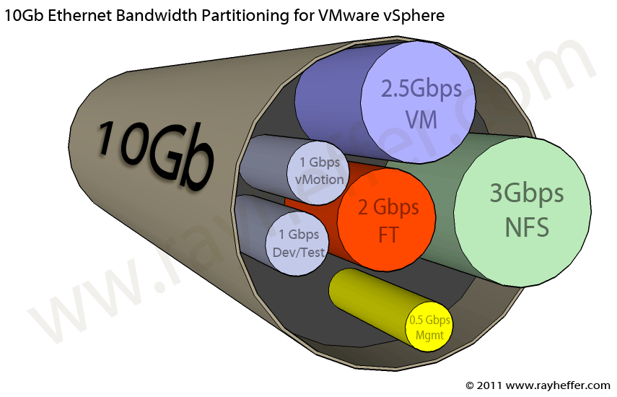
Ograničavanje protoka i oblikovanje saobraćaja

Slide 25
WRED
WRED (Weighted Random Early Detection) je tehnika kod koje se:
  Računa prosečna veličinu slobodnog mesta u redu/redovima.
  Baferuje paket odmah, ako je prosečna veličina ispod minimalnog zadatog threshold-a.
  Ako je prosečna veličina iznad trešholda paket se odmah odbacuje.
  Ako je između minimuma i maksimuma, paket se odbacuje ili baferuje u zavisnosti od prethodne verovatnoće odbacivanja paketa tog tipa.
Prosečna veličina slobodnog mesta u redu se računa po formuli:
    avg=o*(1-2^{-n})+c*(2^{-n})
      gde je n korisnički definisani težinski faktor, o je stari prosek (old), a c trenutni (current).

Slide 26
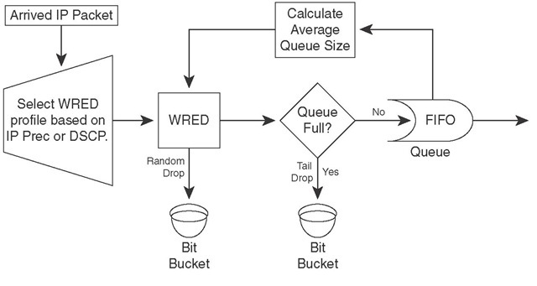
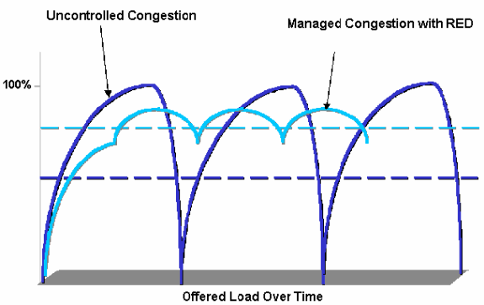
WRED

Slide 27
Klasifikacija saobraćaja
Diferencijalni servisi ili DiffServ je mrežna arhitektura koja specifira jednostavan i skalabilan mehanizam za klasifikovanje i upravljanje mrežnim saobraćajem. Koristi:
  Type of Service (ToS) i
  Differentiated Services Code Point (DSCP)
polja u zaglavlju IP paketa.
Za svaki tip saobraćaja (npr. web protokoli http, https, webproxy se mogu definisati kao jedan tip) administrator definiše jedan broj za identifikaciju servisa, koji se upisuje u ToS polje.
Na osnovu ToS polja mrežni uređaji određuju svoje ponašanje prema tom saobraćaju.
Pojednostavljeno rečeno, klasifikacija ima za cilj upisivanje istog zadatog ToS identifikacionog broja u zaglavlja IP paketa iz iste administratorski definisane grupe protokola.

Slide 28
Traffic Policing and Shaping

Slide 29
Traffic Conditioners
Policing
  Limits bandwidth by discarding traffic.
  Can re-mark excess traffic and attempt to send.
  Should be used on higher-speed interfaces.
  Can be applied inbound or outbound.
Shaping
  Limits excess traffic by buffering.
  Buffering can lead to a delay.
  Recommended for slower-speed interfaces.
  Cannot re-mark traffic.
  Can only be applied in the outbound direction.
Notes:
Traffic conditioners, QoS mechanisms that limit bandwidth, include policing and shaping. Both of these approaches limit bandwidth, but each has different characteristics, as follows:
Policing: Policing typically limits bandwidth by discarding traffic that exceeds a specified rate. However, policing also can re-mark traffic that exceeds the specified rate and attempt to send the traffic anyway. Because of the drop behavior of policing TCP retransmits, policing should be used on higher-speed interfaces. Policing can be applied inbound or outbound on an interface. Traffic policing tools are often configured on interfaces at the edge of a network to limit the rate of traffic entering or leaving the network. In the most common traffic-policing configurations, traffic that conforms is transmitted and traffic that exceeds is sent with a decreased priority or is dropped. Such priorities can be based on IP precedence or DSCP.
Shaping: Shaping limits excess traffic, not by dropping it but by buffering it. This buffering of excess traffic can lead to delay. Because of this delay, shaping is recommended for slower-speed interfaces. Unlike policing, shaping cannot re-mark traffic. As a final contrast, shaping can be applied only in the outbound direction on an interface. Traffic shaping can be used to account for speed mismatches, which are common in nonbroadcast multiaccess (NBMA) networks such as Frame Relay and ATM.

Slide 30
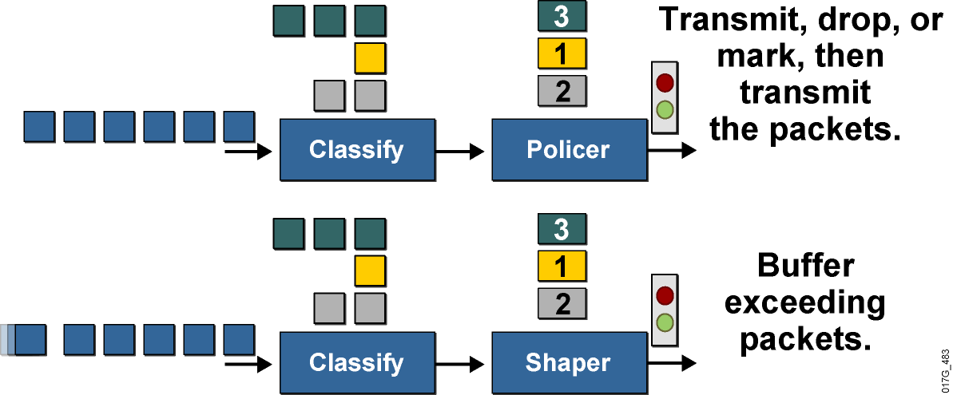
Traffic Policing and Shaping Overview
These mechanisms must classify packets before policing or shaping the traffic rate.
Traffic policing typically drops or marks excess traffic to stay within a traffic rate limit.
Traffic shaping queues excess packets to stay within the desired traffic rate.
Notes:
Both traffic shaping and policing mechanisms are traffic-conditioning mechanisms that are used in a network to control the traffic rate. Both mechanisms use classification so that they can differentiate traffic. They both measure the rate of traffic and compare that rate to the configured traffic-shaping or traffic-policing policy.
The difference between traffic shaping and policing can be described in terms of their implementation. Traffic policing drops excess traffic to control traffic flow within specified rate limits. Traffic policing does not introduce any delay to traffic that conforms to traffic policies. Traffic policing can cause more TCP retransmissions, because traffic in excess of specified limits is dropped.
Traffic-policing mechanisms such as class-based policing or committed access rate (CAR) also have marking capabilities in addition to rate-limiting capabilities. Instead of dropping the excess traffic, traffic policing can mark and then send the excess traffic. This feature allows the excess traffic to be re-marked with a lower priority before the excess traffic is sent out.
Traffic shaping buffers excessive traffic so that the traffic stays within the desired rate. With traffic shaping, traffic bursts are smoothed out by queuing the excess traffic to produce a steadier flow of data. Reducing traffic bursts helps reduce congestion in the network. Traffic shapers such as class-based shaping, Frame Relay traffic shaping (FRTS), or virtual IP (VIP)-based distributed traffic shaping (DTS) in Cisco IOS software do not have the ability to mark traffic.

Slide 31
Why Use Policing? Why Use Shaping?
To limit access to resources when high-speed access is used but not desired (subrate access)
To limit the traffic rate of certain applications or traffic classes
To mark down (recolor) exceeding traffic at Layer 2 or
Layer 3
To prevent and manage congestion in ATM, Frame Relay, and Metro Ethernet networks, where asymmetric bandwidths are used along the traffic path
To regulate the sending traffic rate to match the subscribed (committed) rate in ATM, Frame Relay, or Metro Ethernet networks
To implement shaping at the network edge
Notes:
Why Use Policing?
Limiting the access rate on an interface when high-speed physical infrastructure is used in transport. Rate limiting is typically used by service providers to offer customers subrate access. For example, a customer may have an Optical Carrier-3 (OC-3) connection to the service provider but pay only for a T1 access rate. The service provider can rate-limit the customer traffic to T1 speed.
Engineering bandwidth so that traffic rates of certain applications or classes of traffic follow a specified traffic-rate policy. For example, traffic from file-sharing applications may be rate-limited to 64 kbps maximum.
Re-marking excess traffic with a lower priority at Layer 2 and Layer 3 or both before sending the excess traffic out. Cisco class-based traffic policing can be configured to mark packets at both Layer 2 and Layer 3. For example, excess traffic can be re-marked to a lower differentiated services code point (DSCP) value and also have the Frame Relay discard eligible (DE) bit set before the packet is sent out.
Why Use Shaping?
Traffic shaping is typically used to prevent and manage congestion in ATM, Frame Relay, or Metro Ethernet networks, where asymmetric bandwidths are used along the traffic path. If shaping is not used, then buffering can occur at the slow (usually the remote) end, which can lead to queuing and cause delays, and overflow, which can cause packet drops.
Traffic shaping is an attempt to control traffic in ATM, Frame Relay, or Metro Ethernet networks to optimize or guarantee performance, low latency, or bandwidth. Traffic shaping deals with the concepts of classification, queue disciplines, enforcing policies, congestion management, quality of service (QoS), and fairness.
Traffic shaping provides a mechanism to control the volume of traffic being sent into a network (bandwidth throttling) by not allowing the traffic to burst above the subscribed (committed) rate. For this reason, traffic-shaping schemes need to be implemented at the network edges, as with ATM, Frame Relay, or Metro Ethernet, to control the traffic entering the network. It also may be necessary to identify traffic with a granularity that allows the traffic-shaping control mechanism to separate traffic into individual flows and shape them differently.

Slide 32
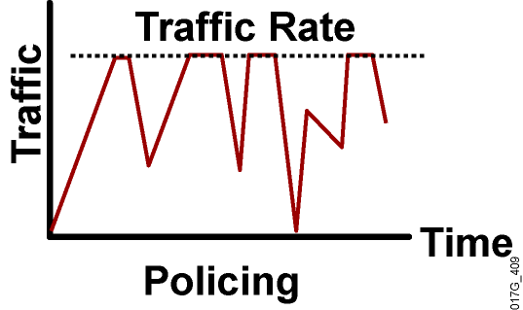
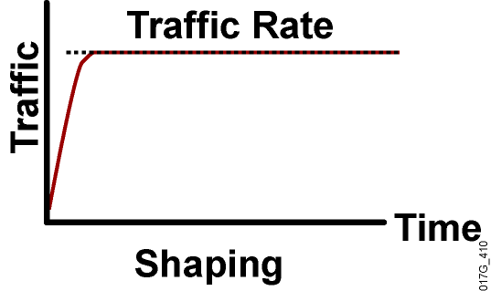
Policing Versus Shaping
Incoming and outgoing directions.
Out-of-profile packets are dropped.
Dropping causes TCP retransmits.
Policing supports packet marking or re-marking.
Outgoing direction only.
Out-of-profile packets are queued until a buffer gets full.
Buffering minimizes TCP retransmits.
Marking or re-marking not supported.
Shaping supports interaction with Frame Relay congestion indication.
Notes:
Policing can be applied to either the inbound or outbound direction, while shaping can be applied only in the outbound direction. Policing drops nonconforming traffic instead of queuing the traffic like shaping. Policing also supports marking of traffic. Traffic policing is more efficient in terms of memory utilization than traffic shaping because no additional queuing of packets is needed.
Both traffic policing and shaping ensure that traffic does not exceed a bandwidth limit, but each mechanism has different impacts on the traffic:
Policing drops packets more often, generally causing more retransmissions of connection-oriented protocols, such as TCP.
Shaping adds variable delay to traffic, possibly causing jitter. Shaping queues excess traffic by holding packets in a shaping queue. Traffic shaping is used to shape the outbound traffic flow when the outbound traffic rate is higher than a configured rate. Traffic shaping smoothes traffic by storing traffic above the configured rate in a shaping queue. Therefore, shaping increases buffer utilization on a router and causes unpredictable packet delays. Traffic shaping can also interact with a Frame Relay network, adapting to indications of Layer 2 congestion in the WAN. For example, if the backward-explicit congestion notification (BECN) bit is received, the router can lower the rate limit to help reduce congestion in the Frame Relay network.

Slide 33
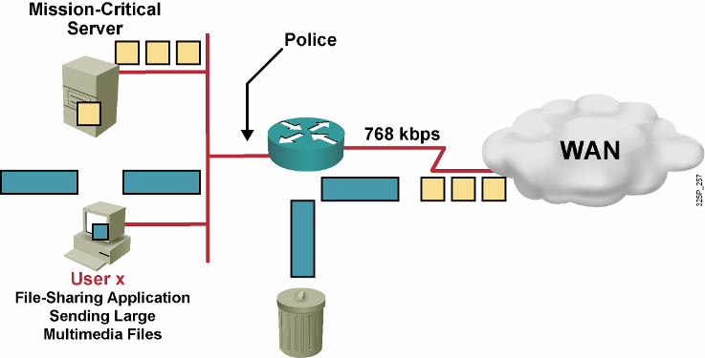
Traffic Policing Example
Do not rate-limit traffic from mission-critical server.
Rate-limit file-sharing application traffic to 56 kbps.
Notes:
Traffic policing divides the shared resource (the upstream WAN link) among many flows. In the example shown, the router Fast Ethernet interface has an input traffic-policing policy applied to it in which the mission-critical server traffic rate is not limited but the user x file-sharing application traffic rate is limited to 56 kbps. All file-sharing application traffic from user x that exceeds the rate limit of 56 kbps will be dropped.

Slide 34
Token Bucket
Mathematical model used by routers and switches to regulate traffic flow.
Tokens represent permission to send a number of bits into the network.
Tokens are put into the bucket at a certain rate by IOS.
Token bucket holds tokens.
Tokens are removed from the bucket when packets are forwarded.
If there are not enough tokens in the bucket to send the packet, traffic conditioning is invoked (shaping or policing).
Notes:
The token bucket is a mathematical model used by routers and switches to regulate traffic flow. The model has two basic components:
Tokens: Each token represents permission to send a fixed number of bits into the network. Tokens are put into a token bucket at a certain rate by Cisco IOS software.
Token bucket: A token bucket has the capacity to hold a specified number of tokens. Each incoming packet, if forwarded, takes tokens from the bucket representing the packet size. If the bucket fills to capacity, newly arriving tokens are discarded. Discarded tokens are not available to future packets. If there are not enough tokens in the token bucket to send the packet, the traffic-conditioning mechanisms may take the following actions:
Wait for enough tokens to accumulate in the bucket (traffic shaping)
Discard the packet (traffic policing)
Using a single token bucket model, the measured traffic rate can conform to or exceed the specified traffic rate. The measured traffic rate is conforming if there are enough tokens in the token bucket to transmit the traffic. The measured traffic rate is exceeding if there are not enough tokens in the token bucket to transmit the traffic.

Slide 35
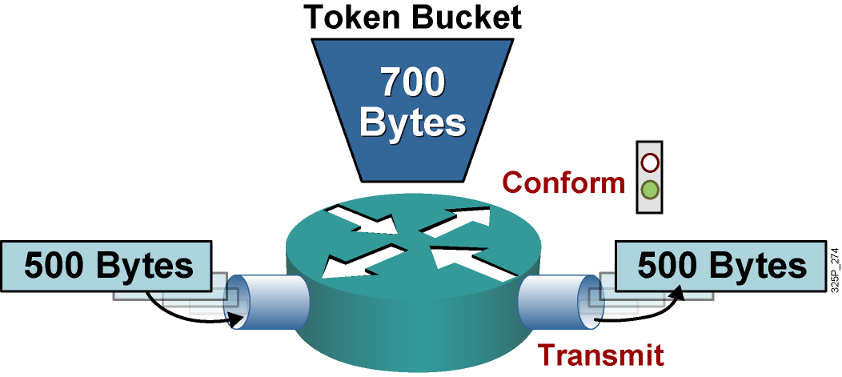
Single Token Bucket
If sufficient tokens are available (conform action):
  Tokens equivalent to the packet size are removed from the bucket.
  The packet is transmitted.
Notes:
This graphic shows a single token bucket traffic policing implementation.
Starting with a current capacity of 700 bytes worth of tokens accumulated in the token bucket, when a 500-byte packet arrives at the interface, its size is compared to the token bucket capacity (in bytes).
The 500-byte packet conforms to the rate limit (500 bytes is less than 700 bytes), and the packet is forwarded: 500 bytes worth of tokens are taken out of the token bucket, leaving 200 bytes worth of tokens for the next packet.

Slide 36
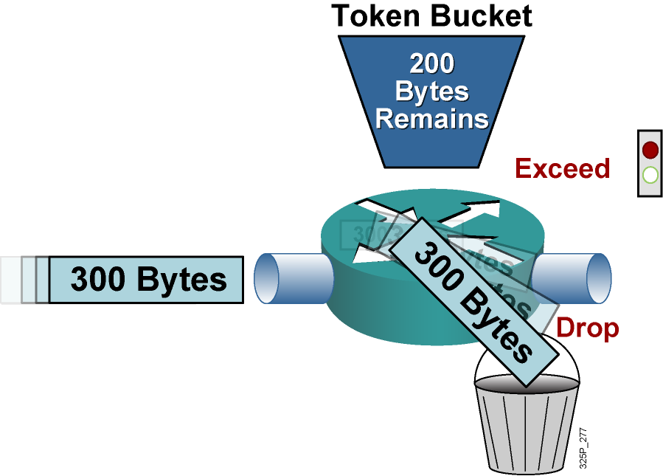
Single Token Bucket Exceed Action
If sufficient tokens are not available (exceed action):
  Drop (or mark) the packet.
Notes:
Continuing with the single token bucket example from the previous figure, when the next 300-byte packet arrives immediately after the first packet, no new tokens have been added to the bucket (which is done periodically).
This packet exceeds the rate limit. The current packet size (300 bytes) is greater than the current capacity of the token bucket (200 bytes), and the exceed action is performed.
In traffic policing, the exceed action can be to drop or mark the packet.

Slide 37
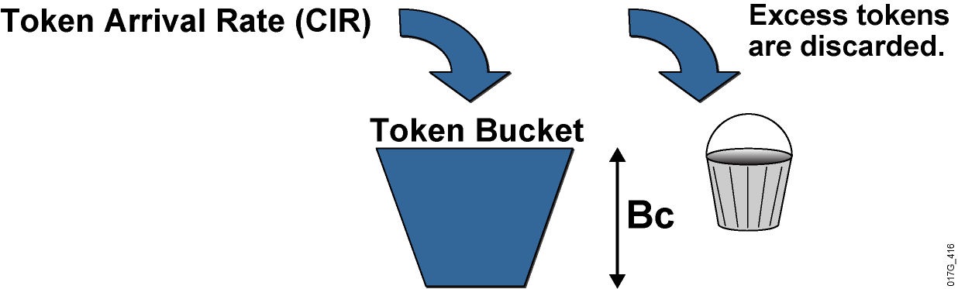
Single Token Bucket Class-Based Policing
  Bc is normal burst size.
  Tc is the time interval.
  CIR is the committed information rate.
  CIR = Bc / Tc
Notes:
Token bucket operations rely on parameters such as CIR, committed burst (Bc), and committed time interval (Tc). Bc is known as the normal burst size. The mathematical relationship between CIR, Bc, and Tc is as follows:
CIR (bps) = Bc (bits) / Tc (sec)
With traffic policing, new tokens are added into the token bucket based on the interpacket arrival rate and the CIR. Every time a packet is policed, new tokens are added back into the token bucket. The number of tokens added back into the token bucket is calculated as follows:
(Current Packet Arrival Time – Previous Packet Arrival Time) * CIR
An amount (Bc) of tokens is forwarded without constraint in every time interval (Tc). For example, if 8000 bits (Bc) worth of tokens are placed in the bucket every 250 ms (Tc), the router can steadily transmit 8000 bits every 250 ms if traffic arrives constantly at the router.
CIR (normal burst rate) = 8,000 bits (Bc) / 0.25 seconds (Tc) = 32 kbps
When configuring Cisco IOS class-based traffic policing, it is recommended that you allow Cisco IOS software to automatically calculate the optimal Bc and Tc value based on the configured CIR.
Without any excess bursting capability, if the token bucket fills to capacity (Bc of tokens), the token bucket overflows and newly arriving tokens are discarded. Using the example, in which the CIR is 32 kbps (Bc = 8000 bits and Tc = 0.25 seconds), the maximum traffic rate can never exceed a hard rate limit of 32 kbps.

Slide 38
NBAR
NBAR - Network-Based Application Recognition
NBAR omogućava
  Klasifikaciju saobraćaja na
    Mrežnom,
    Transportnom, ili
    Aplikativnom nivou OSI modela (!!!)
      Ovo omogućava detekciju npr. Torenta bez navođenja portova, već specificiranja specifičnosti formata protokola aplikativnog nivoa
  Markiranje saobraćaja
  Policing and shaping

Slide 39
Primer NBAR konfiguracije rutera
Kreiranje klasa radi klasifikacije različitih tipova saobraćaja u globalnom config modu rutera C2811:
    class-map match-all KlasaZaEmail
    match protocol pop3
    match protocol imap
    match protocol smtp
    class-map match-all KlasaZaVoIP
    match protocol sip
    match protocol h323
    match protocol skinny
    match protocol rtp
    class-map match-all KlasaFileDownload
    match protocol ftp
    match protocol BitTorrent
    class-map match-all KlasaZaWeb
    match protocol http
    match protocol https

Slide 40
Primer NBAR konfiguracije rutera
Kreiranje polisa (globalni config mod)
    policy-map policyIN
    Class KlasaZaEmail
    policy 10 000 000
    class KlasaZaVoIP
    policy 30 000 000
    class ClassWeb
    policy 15 000 000
    class KlasaFileDownload
    policy 15 000 000
    class class-default
    policy 30 000 000
Uključivanje polise na interfejsu (u modu interfejsa)
  service-policy input policyIN

